Slide 1
My ‘Data Road’
Bolin Kong

Slide 2



My Data Road
Bachelor Major - GIS
CitiCorp’s - CSTC - COTS
CitiCorp’s - CSTC - Risk
WifiMaster

Slide 3
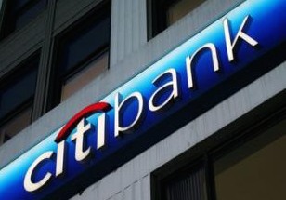








CitiCorp’s - CSTC - COTS

Slide 4



CitiCorp’s - CSTC - Risk

Slide 5


WifiMaster

Slide 6
Profile - Future

Slide 7
Thank you

